Slide 1
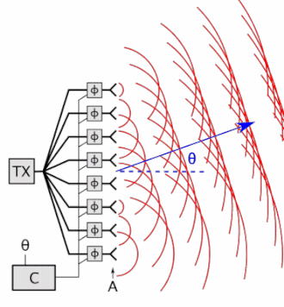
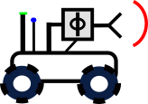
Title and PIs
Project Summary: investigating the intersection of AI, autonomy, and networked communication, focusing on robots that self-configure to build covert, reliable communication links
Research Goals: to investigate self-configuring algorithms and technologies for robotic systems to create a dynamic multi-robot communications system
Anticipated Outcomes: constructively characterize the minimum required number of agents for generating an arbitrary far-field radiation pattern, develop policy gradient-based accelerated RL algorithms for distributed beamforming
Army Capability: increased command post (CP) maneuverability while maintaining covert operations through sophisticated signature management strategies
Coherent
Phase Front
Distributed
Across
Robots
N-element Phased Array
Phase Controller
Concept: develop autonomous multi-robot system to synthesize beams at desired locations using constructive interference while generating nulls for covert communication using destructive interference
Current milestones: characterize constructively the minimum number of agents required for generating an arbitrary far-field radiation pattern, and develop novel policy gradient-based accelerated RL algorithms to solve the problem of distributed beamforming
Data: (can be from DVPG or other sources)
Scenarios and Experiments: optimization-based beampattern matching with improved speed in presence of uncertain narrowband fading
ARL platforms, testbeds or infrastructure:
Connections with other Projects:
Roadblocks: (only needed if there is something that needs to be resolved)
What’s Next:

Slide 2
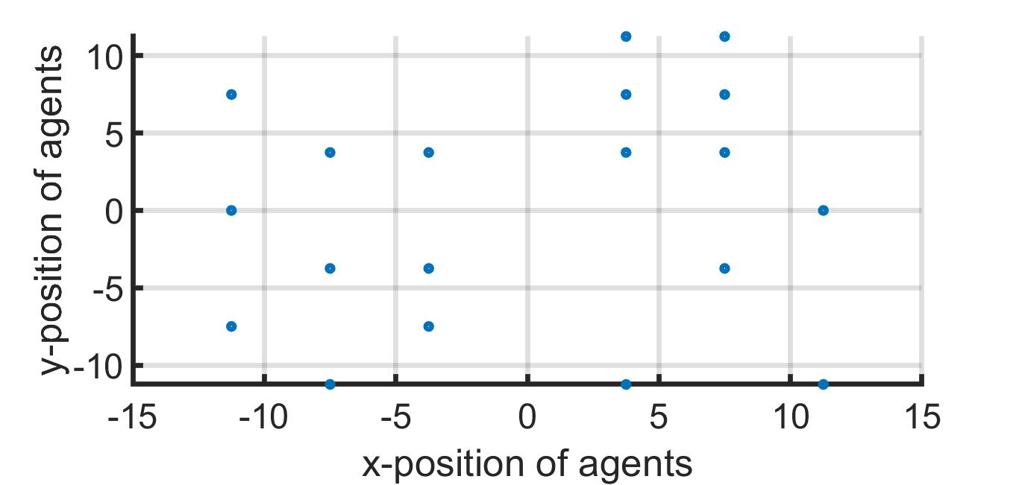
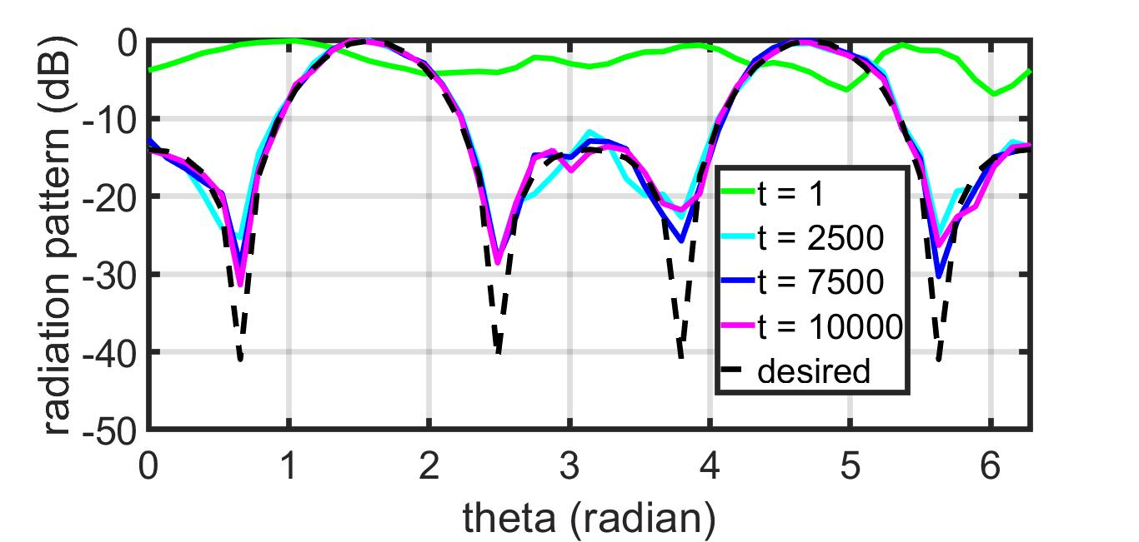
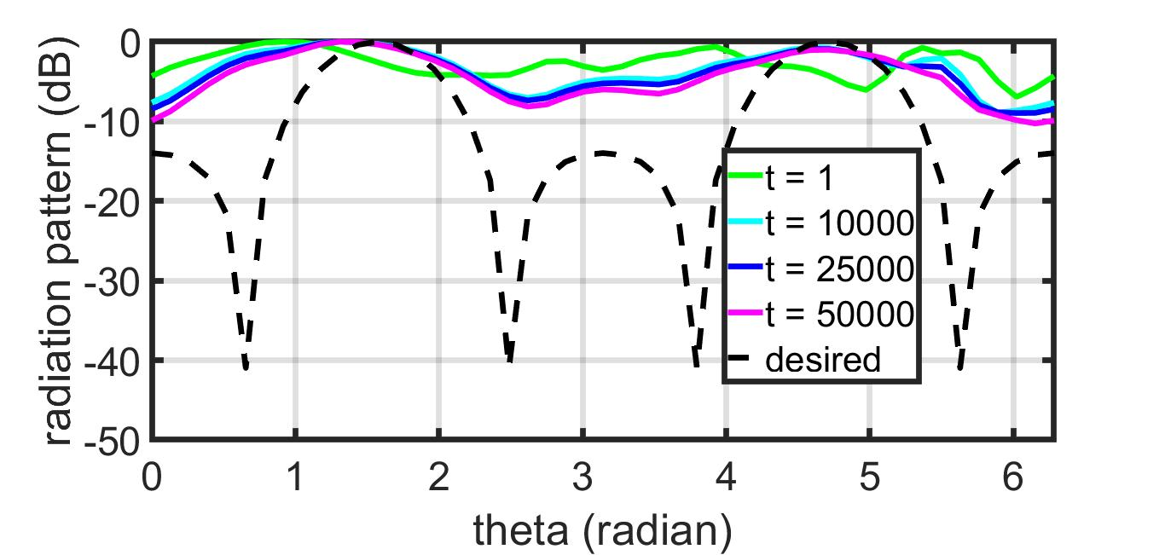
INNOVATION: A description of the research innovation being worked
Key Technical Demonstration/Example:
Primary Research Question:
What observable metrics can be used to train a multi-robot system to flexibly work with humans and other agents when combined with machine learning, artificial intelligence, and human-in-the-loop approaches?
Proposed
Key Publications:
U. Jang, Su. Jha, So. Jha, and B. Jalaian, "Detecting Adversarial Examples Using Data Manifolds", IEEE MILCOM 2018
Su. Jha, So. Jha, B. Jalaian, A. Swami, SET 262 "Artificial Intelligence for Military Multisensor Fusion Engines", November 2018
N. Papernot, P. McDaniel, I. Goodfellow, So. Jha, Z Berkay Celik, and A. Swami. Practical black-box attacks against machine learning. In Proceedings of the 2017 ACM on Asia Conference on Computer and Communications Security, pages 506–519. ACM, 2017.
N. Papernot, P. McDaniel, So. Jha, M. Fredrikson, Z Berkay Celik, and A. Swami. The limitations of deep learning in adversarial settings. In Security and Privacy (EuroS&P), 2016 IEEE European Symposium on, pages 372–387. IEEE, 2016.
GD
The proposed IPG algorithm is robust to narrowband fading and converges faster than traditional algorithms. The above results are for uniform weightage of samples. Note that, faster matching of nulls has been observed for non-linear weightage of samples.

Slide 3
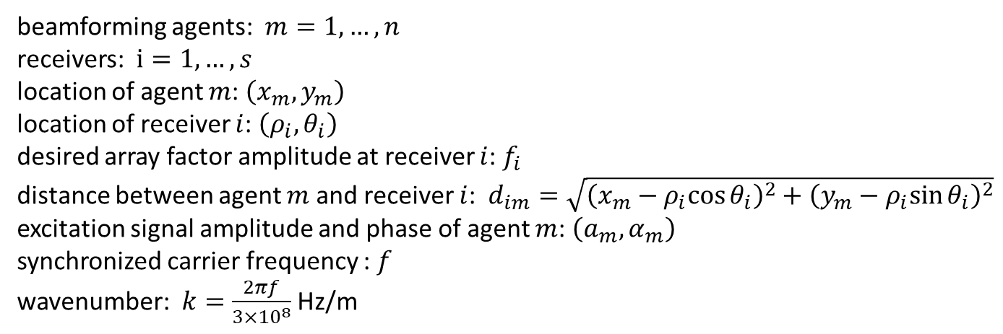
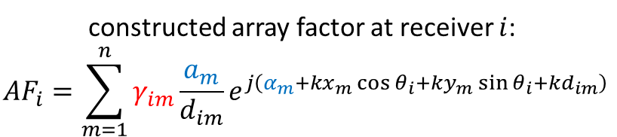
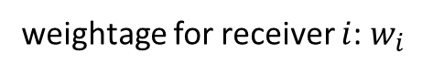
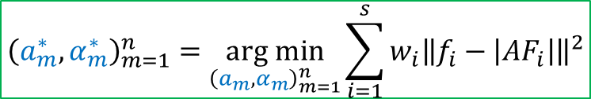
Problem Formulation
beamforming agents: $m=1,…,n$
receivers: $i=1,…,s$
location of agent $m$: $\left(x_{m},y_{m}\right)$
location of receiver $i$: $\left(ρ_{i},θ_{i}\right)$
desired array factor amplitude at receiver $i$: $f_{i}$
distance between agent $m$ and receiver $i$: $d_{im}=\sqrt{{\left(x_{m}−ρ_{i}cos{θ_{i}}\right)}^{2}+{\left(y_{m}−ρ_{i}sin{θ_{i}}\right)}^{2}}$
excitation signal amplitude and phase of agent $m$: $\left(a_{m},α_{m}\right)$
synchronized carrier frequency : $f$
wavenumber: $k=\frac{2πf}{3×{10}^{8}}$ Hz/m
constructed array factor at receiver $i$:
$${AF}_{i}=\sum_{m=1}^{n}{γ_{im}\frac{a_{m}}{d_{im}}e^{j\left(α_{m}+kx_{m}\cos{θ_{i}}+ky_{m}\sin{θ_{i}+kd_{im}}\right)}}$$
unknown multipath fading
control parameters
weightage for receiver $i$: $w_{i}$
$${\left(a_{m}^{∗},α_{m}^{∗}\right)}_{m=1}^{n}=\underset{{\left(a_{m},α_{m}\right)}_{m=1}^{n}}{arg min}{\sum_{i=1}^{s}{w_{i}{\left\|f_{i}−\left|{AF}_{i}\right|\right\|}^{2}}}$$

Slide 4
Performance Measures of a Beamforming Approach
open-loop or closed-loop
do the agents need feedback from the beam receivers and null receivers?
unlikely to get feedback from null receivers, as they are potential adversaries
guarantee convergence to a local or global optimum solution
does the algorithm converge for arbitrary initialization? (future work)
does there exist an exact solution?
how many transmitting agents are required? (ongoing work)
rate of convergence
require a smaller number of iterations for faster establishment of communication link with receivers
characterize how many iterations are required to get a close enough solution (future work)
what is considered as close enough?
measure the gap in dB
robustness
channel noise: channel parameters may not be known precisely
measurement noise: receiver locations may not be known precisely (future work)
directivity
does the constructed combined signal spread towards directions other than the specified receivers? (future work)
node placement and node selection
optimize position and the number of active agents (future work)

Slide 5
Comparison with Related Works
 | Prior Work | Our Work
[1]-[4] | objective: maximizing gain or steering nulls at specific locations | objective: beampattern matching advantages: precise control over desired power at multiple locations, inherent simultaneous beamforming and nullforming in constructive manner, can include additional constraints (limited transmit power, derivative constraints when receiver locations are not precisely known)
[5]-[7] | utilize receiver feedbacks | does not require receiver feedbacks
[8], [9] | sparse beamforming, mobile agents | fixed number of agents, stationary agents, in future, will be incorporated in framework of [8]
[7], [10] | channel model-free [7], probabilistic channel prediction and path planning for minimizing power [10] | feedback-free, unlike [7] beampattern matching, unlike [10]
[11] | receiver feedback-free | does not assume line-of-sight channels
[1] D Richard Brown, Upamanyu Madhow, Patrick Bidigare, and Soura Dasgupta. Receiver-coordinated distributed transmit nullforming with channel state uncertainty. In 2012 46th Annual Conference on Information Sciences and Systems (CISS), pages 1–6. IEEE, 2012.
[2] Yongsheng Fan, Yuanping Zhou, Donglin He, and Wenlong Xia. Fast transmit beamforming with distributed antennas. IEEE Antennas and Wireless Propagation Letters, 16:121–124, 2016.
[3] Sairam Goguri, Ben Peiffer, Raghu Mudumbai, and Soura Dasgupta. A class of scalable feedback algorithms for beam and null-forming from distributed arrays. In 2016 50th Asilomar Conference on Signals, Systems and Computers, pages 1447–1451. IEEE, 2016.
[4] Justin S Kong, Fikadu T Dagefu, and Brian M Sadler. Distributed adaptive beamforming and nullforming for secure wireless communications, March 31 2022. US Patent App. 17/205,355.
[5] Amy Kumar, Raghuraman Mudumbai, Soura Dasgupta, Upamanyu Madhow, and D Richard Brown. Distributed MIMO multicast with protected receivers: A scalable algorithm for joint beamforming and nullforming. IEEE Transactions on Wireless Communications, 16(1):512–525, 2016.
[6] Jemin George, Anjaly Parayil, Cemal Tugrul Yilmaz, Bethany L Allik, He Bai, and Aranya Chakrabortty. Multi-agent coordination for distributed transmit beamforming. In 2020 American Control Conference (ACC), pages 144–149. IEEE, 2020.
[7] Jemin George, Cemal Tugrul Yilmaz, Anjaly Parayil, and Aranya Chakrabortty. A model-free approach to distributed transmit beamforming. In ICASSP 2020-2020 IEEE International Conference on Acoustics, Speech and Signal Processing (ICASSP), pages 5170–5174. IEEE, 2020. [8] Anjaly Parayil, Amrit Singh Bedi, and Alec Koppel. Joint position and beamforming control via alternating nonlinear least-squares with a hierarchical gamma prior. In 2021 American Control Conference (ACC), pages 3513–3518. IEEE, 2021. [9] Tzanis Anevlavis, Jonathan Bunton, Anjaly Parayil, Jemin George, and Paulo Tabuada. To beam or not to beam? beamforming with submodularity-inspired group sparsity. In 2020 59th IEEE Conference on Decision and Control (CDC), pages 390–395. IEEE, 2020. [10] Arjun Muralidharan and Yasamin Mostofi. Energy optimal distributed beamforming using unmanned vehicles. IEEE Transactions on Control of Network Systems, 5(4):1529–1540, 2017.
[11] Samer Hanna, Enes Krijestorac, and Danijela Cabric. Destination-feedback free distributed transmit beamforming using guided directionality. arXiv preprint arXiv:2108.01837, 2021

Slide 6
Our contributions
proposed a novel algorithm: Iteratively Pre-conditioned Gradient-descent for Distributed Beamforming (IPG-DB)
significantly faster than the gradient-descent (GD) based method in [1]
can be incorporated in alternate optimization framework for joint optimization of position, sparsity, and excitation in [1], [2]: replace slower GD with faster IPG-DB
does not rely on receiver feedbacks
does not assume channel fading parameters: robustness to channel noise
[1] Jemin George, Anjaly Parayil, Cemal Tugrul Yilmaz, Bethany L Allik, He Bai, and Aranya Chakrabortty. Multi-agent coordination for distributed transmit beamforming. In 2020 American Control Conference (ACC), pages 144–149. IEEE, 2020.
[2] Anjaly Parayil, Amrit Singh Bedi, and Alec Koppel. Joint position and beamforming control via alternating nonlinear least-squares with a hierarchical gamma prior. In 2021 American Control Conference (ACC), pages 3513–3518. IEEE, 2021.

Slide 7


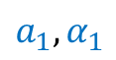
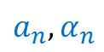
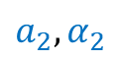
Proposed Settings of Beamforming Agents
server-agent based setting
agents can communicate with a common server
no peer-to-peer communication
what is a server?
can be an auxiliary node, located close to the agents
can exchange information with the agents
can process information (addition, multiplication, etc. basic operations)
need not know the beamforming coefficients, agents’ and receivers’ locations, desired beam and null values
target receivers
server
null receivers
$$a_{1},α_{1}$$
$$a_{2},α_{2}$$
$$a_{n},α_{n}$$

Slide 8
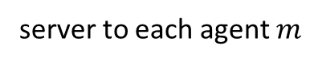
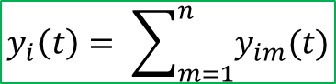
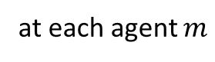
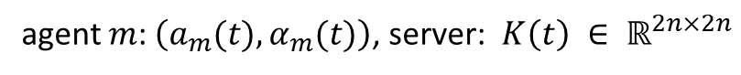
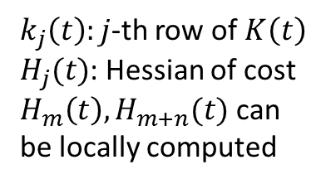
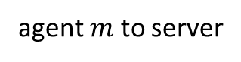
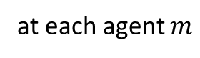
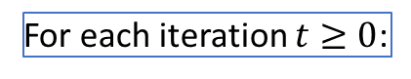
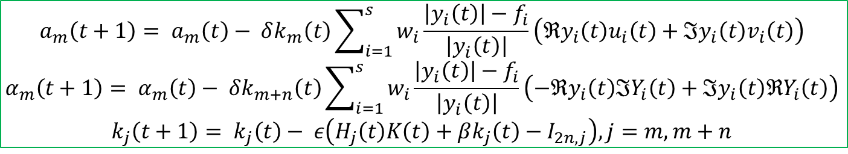
Algorithm Description: IPG-DB
agent $m$: $\left(a_{m}(t),α_{m}(t)\right)$, server: $K\left(t\right) ∈ ℝ^{2n×2n}$
before iterations, server broadcasts to each agent: $ε, β, δ, K(0)$
For each iteration $t≥0$:
$$ζ_{im}=kx_{m}\cos{θ_{i}}+ky_{m}\sin{θ_{i}+kd_{im}}$$
$u_{im}(t)=\frac{1}{d_{im}}\cos\left(α_{m}\left(t\right)+ζ_{im}\right)$, $v_{im}\left(t\right)=\frac{1}{d_{im}}\sin\left(α_{m}\left(t\right)+ζ_{im}\right)$, $y_{im}\left(t\right)=a_{m}(t)\left(u_{im}\left(t\right)+jv_{im}(t)\right)$
at each agent $m$
$\left\{u_{im}\left(t\right),v_{im}\left(t\right),y_{im}\left(t\right), i=1,…,s\right\}$, $k_{m}\left(t\right),k_{m+n}\left(t\right)$
agent $m$ to server
$k_{j}\left(t\right):j$-th row of $K\left(t\right)$
$H_{j}(t)$: Hessian of cost
$H_{m}\left(t\right),H_{m+n}(t)$ can be locally computed
$$y_{i}\left(t\right)= \sum_{m=1}^{n}{y_{im}(t)}$$
at server
$u_{i}\left(t\right)={\left[u_{i1}\left(t\right),…,u_{in}\left(t\right)\right]}^{T}$, $v_{i}\left(t\right)={\left[v_{i1}\left(t\right),…,v_{in}\left(t\right)\right]}^{T}$, $Y_{i}\left(t\right)={\left[y_{i1}\left(t\right),…,y_{in}\left(t\right)\right]}^{T}$
$\left\{y_{i}\left(t\right), i=1,…,s\right\}$,$\left\{u_{i}\left(t\right),v_{i}\left(t\right),Y_{i}\left(t\right), i=1,…,s\right\}$, $K\left(t\right)$
server to each agent $m$
$$a_{m}\left(t+1\right)= a_{m}\left(t\right)− δk_{m}\left(t\right)\sum_{i=1}^{s}{w_{i}\frac{\left|y_{i}\left(t\right)\right|−f_{i}}{\left|y_{i}\left(t\right)\right|}}\left(ℜy_{i}\left(t\right)u_{i}\left(t\right)+ℑy_{i}\left(t\right)v_{i}\left(t\right)\right)$$
$$α_{m}\left(t+1\right)= α_{m}\left(t\right)− δk_{m+n}\left(t\right)\sum_{i=1}^{s}{w_{i}\frac{\left|y_{i}\left(t\right)\right|−f_{i}}{\left|y_{i}\left(t\right)\right|}}\left(−ℜy_{i}\left(t\right)ℑY_{i}\left(t\right)+ℑy_{i}\left(t\right)ℜY_{i}\left(t\right)\right)$$
$$k_{j}\left(t+1\right)= k_{j}\left(t\right)− ε\left(H_{j}\left(t\right)K\left(t\right)+βk_{j}\left(t\right)−I_{2n,j}\right), j=m,m+n$$
at each agent $m$

Slide 9
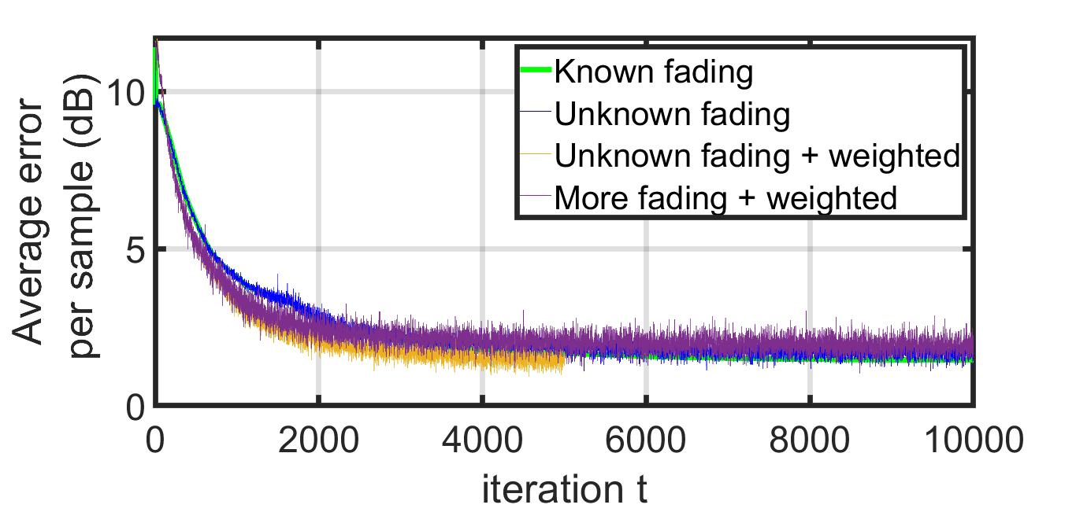
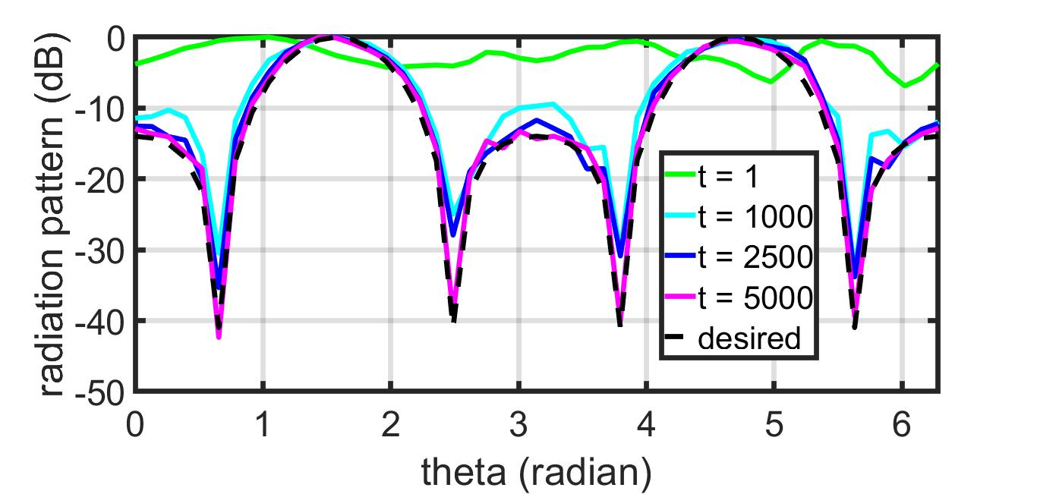
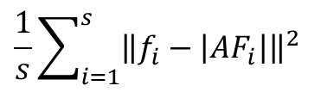
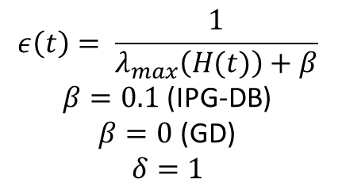
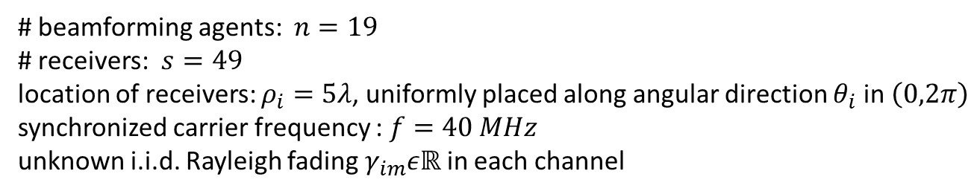
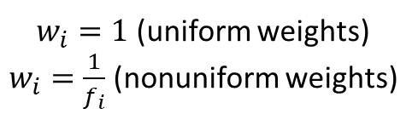
Empirical Results: Synthetic Data
# beamforming agents: $n=19$
# receivers: $s=49$
location of receivers: $ρ_{i}=5λ$, uniformly placed along angular direction $θ_{i}$ in $\left(0,2π\right)$
synchronized carrier frequency : $f=40 MHz$
unknown i.i.d. Rayleigh fading $γ_{im}εℝ$ in each channel
$w_{i}=1$ (uniform weights)
$w_{i}=\frac{1}{f_{i}}$ (nonuniform weights)
IPG-DB
$$\frac{1}{s}\sum_{i=1}^{s}{{\left\|f_{i}−\left|{AF}_{i}\right|\right\|}^{2}}$$
$$ε\left(t\right)= \frac{1}{λ_{max}\left(H(t)\right)+β}$$
$β=0.1$ (IPG-DB)
$β=0$ (GD)
$$δ=1$$
GD
IPG-DB

Slide 10
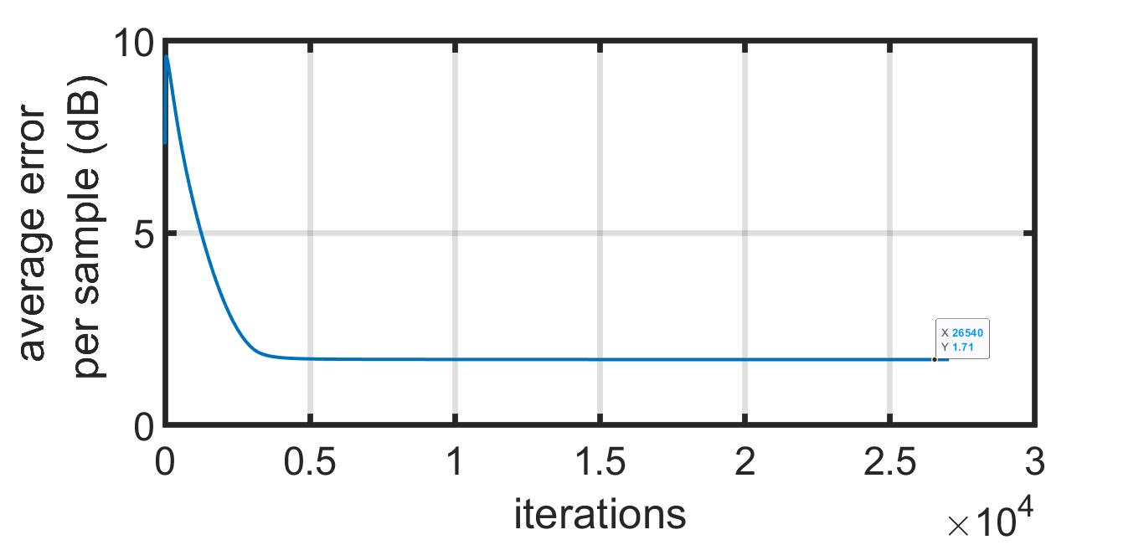
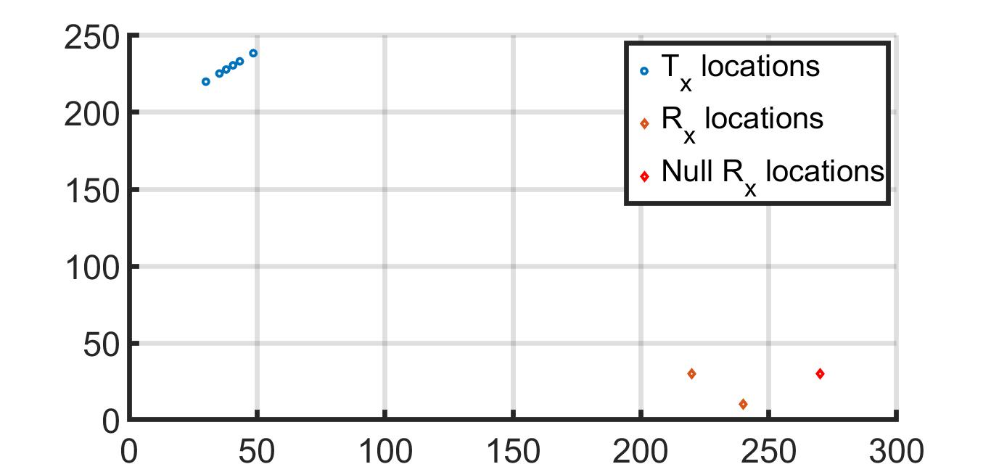
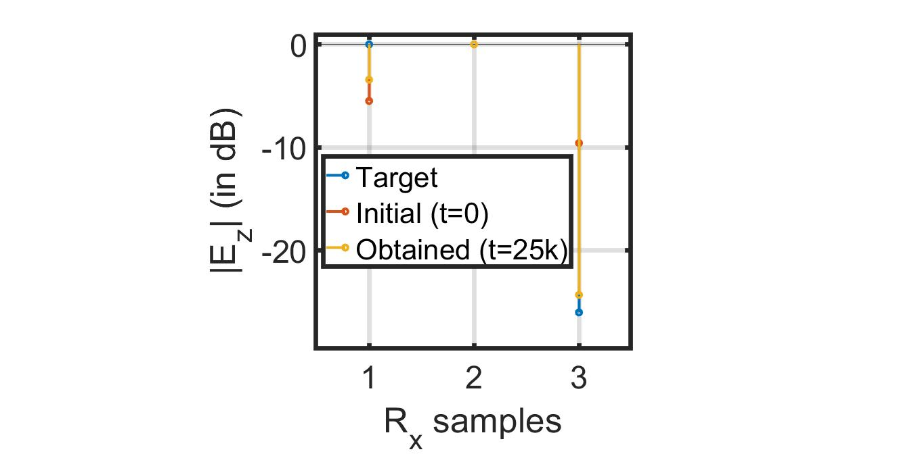

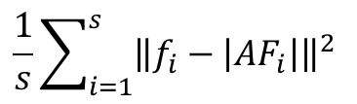
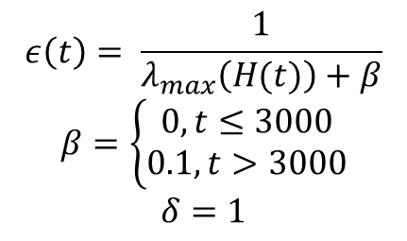
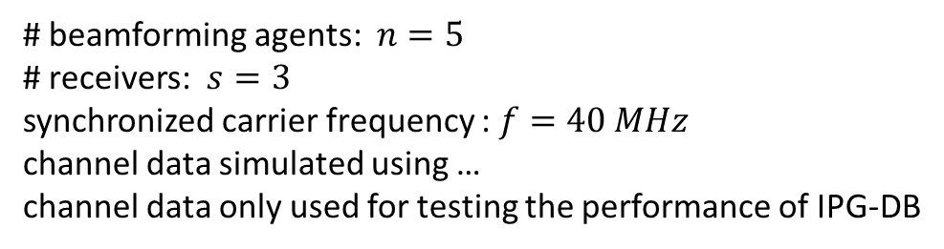
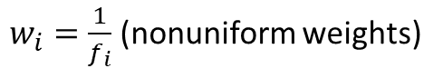
Empirical Results: LA Urban Environment
# beamforming agents: $n=5$
# receivers: $s=3$
synchronized carrier frequency : $f=40 MHz$
channel data simulated using …
channel data only used for testing the performance of IPG-DB
$w_{i}=\frac{1}{f_{i}}$ (nonuniform weights)
$$\frac{1}{s}\sum_{i=1}^{s}{{\left\|f_{i}−\left|{AF}_{i}\right|\right\|}^{2}}$$
$$ε\left(t\right)= \frac{1}{λ_{max}\left(H(t)\right)+β}$$
$β=\left\{\begin{aligned}0, t≤3000 \\ 0.1, t>3000\end{aligned}\right.$
$$δ=1$$
IPG-DB
phase front data generated from one of the five Tx in the scene, that is used for testing the performance of IPG-DB

Slide 11
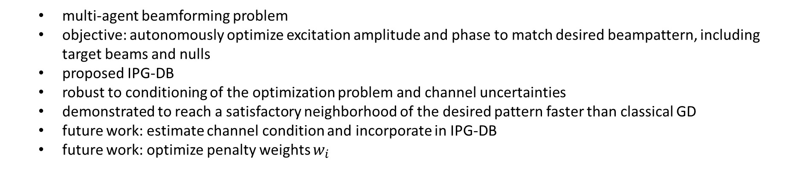
Summary
multi-agent beamforming problem
objective: autonomously optimize excitation amplitude and phase to match desired beampattern, including target beams and nulls
proposed IPG-DB
robust to conditioning of the optimization problem and channel uncertainties
demonstrated to reach a satisfactory neighborhood of the desired pattern faster than classical GD
future work: estimate channel condition and incorporate in IPG-DB
future work: optimize penalty weights $w_{i}$
Work submitted to: Kushal Chakrabarti, Amrit S. Bedi, Fikadu T. Dagefu, Jeffrey N. Twigg, and Nikhil Chopra. Fast distributed beamforming without Receiver Feedback. In 2016 56th Annual Asilomar Conference on Signals, Systems, and Computers. 2022. (under review)

